Slide 1
Forms and JavaScript

Slide 2
Intro: I am Shawn

Slide 3
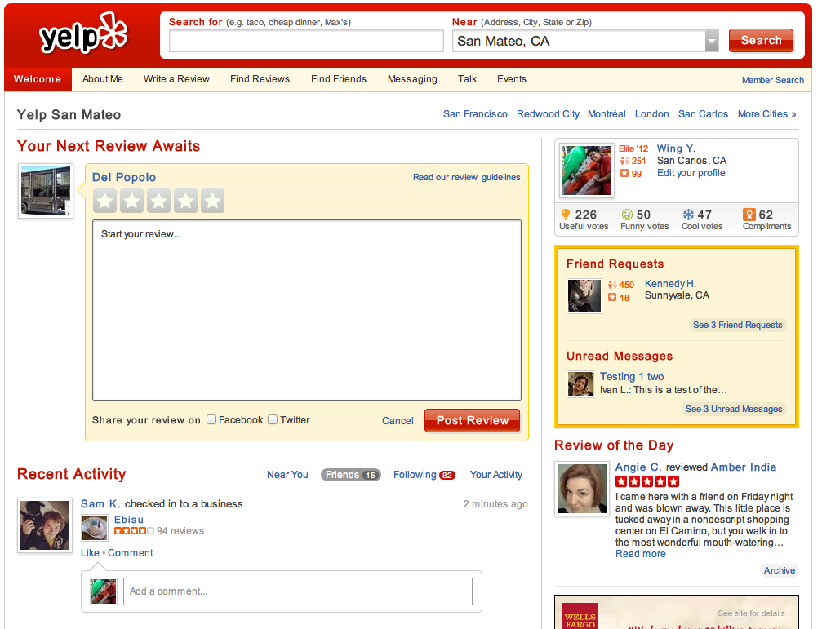
Forms are everywhere

Slide 4
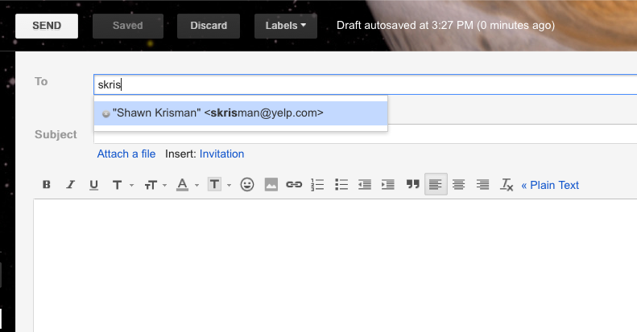
Forms + JavaScript => Happiness

Slide 5
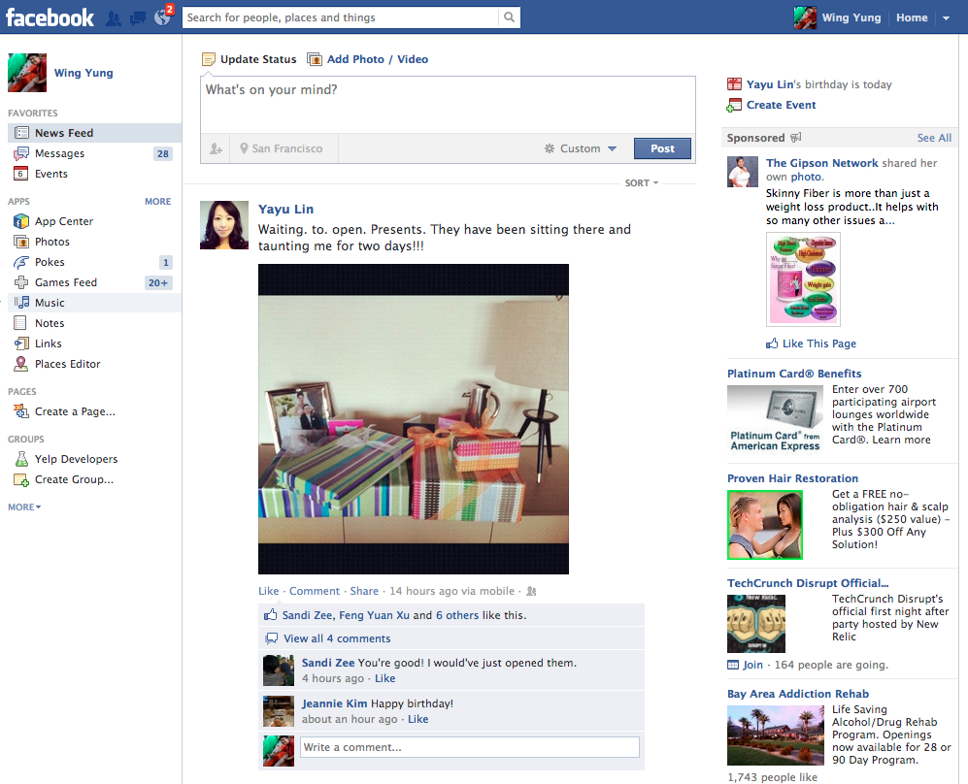
How many forms are on this page?

Slide 6
Today's lecture
users submit information to websites through forms
JavaScript is generally used to enhance the user experience

Slide 7
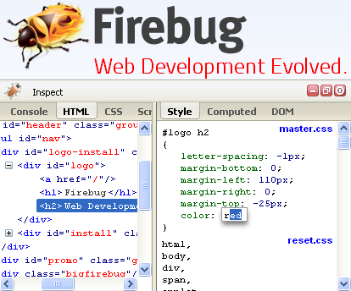

Before we start
Make sure you have Chrome or Firefox + Firebug
see web requests
run JavaScript
interact with HTML
Be ready to experiment!

Slide 8
HTML Forms

Slide 9
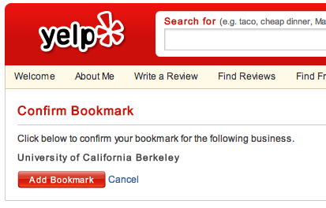
Yelp Bookmarks
<form method="post" action="/bookmark/add_biz_confirm" name="bookmark_confirm_form">
<p>Click below to confirm your bookmark for the following business.</p>
<p><strong>University of California Berkeley</strong></p>
<input type="hidden" name="biz_id" value="0iSN6PgiXKP4oSVL037ATg">
<span class="ybtn"><button type="submit" value="submit" class="btn-r-s"><span>Add Bookmark</span></button></span>
<a href="/biz/university-of-california-berkeley-berkeley">Cancel</a>
<input type="hidden" name="return_url" value="/biz/university-of-california-berkeley-berkeley">
</form>
Notes:
this is a basic HTML page that users without JavaScript can use. people rarely see this

Slide 10
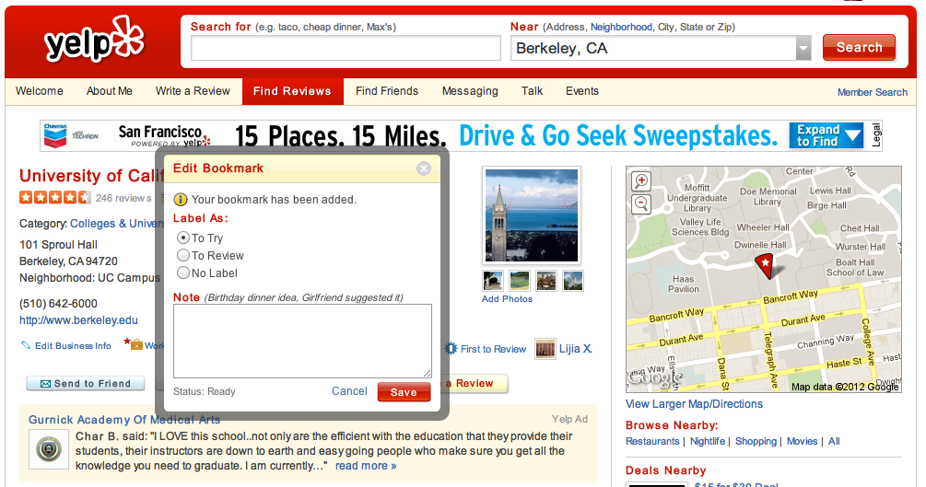
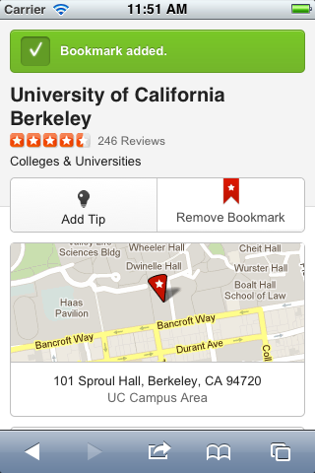

Slide 11
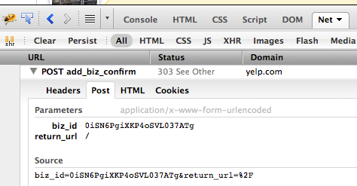
Behind the Veil

Slide 12
Why is the the Form so Awesome?
Its the main way people send data to a web server.
Forms allow websites to get text, selections and even aggregate selections from users.
Since it's regular HTML, you can make forms look great with CSS.

Slide 13
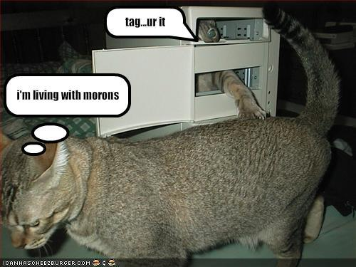
Form tag
<form
method="post"
action="/bookmark/add_biz_confirm"
name="bookmark_confirm_form">
...
</form>
Notes:
method: HTTP method. action: the URL to interact with

Slide 14

Simplest Form
<html>
<body>
<form method="POST" action="http://echo.wingerz.com/echo">
<input type="text" name="name">
<input type="submit" value="Submit">
</form>
</body>
</html>
http://echo.wingerz.com/forms.html

Slide 15
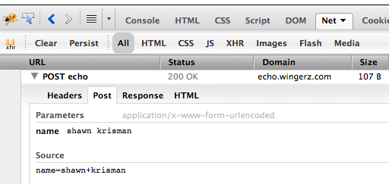
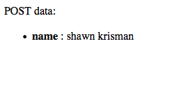
once the server gets data, it can take action
save to a database
send an email
charge a credit card

Slide 16
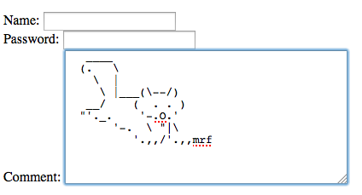
Inputs: text/textarea/password
<label for="name">Name:</label>
<input type="text" name="name" id="name">
<br>
<label for="password">Password:</label>
<input type="password" name="password" id="password">
<br>
<label for="comment">Comment:</label>
<textarea name="comment" id="comment" rows="10" cols="40"></textarea>
http://echo.wingerz.com/inputs.html

Slide 17
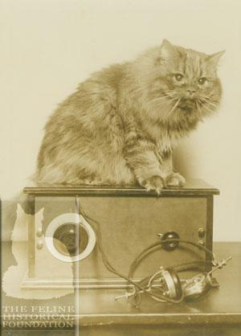

Inputs: radio
<input type="radio" name="gender" value="M" id="gender-m"><label for="gender-m">Male</label>
<input type="radio" name="gender" value="F" id="gender-f"><label for="gender-f">Female</label>
http://echo.wingerz.com/inputs.html

Slide 18

Inputs: checkbox
<p>I enjoy working with...</p>
<input type="checkbox" name="tech" value="html" checked id="tech-html"><label for="tech-javascript">HTML</label>
<input type="checkbox" name="tech" value="css" id="tech-css"><label for="tech-css">CSS</label>
<input type="checkbox" name="tech" value="javascript" id="tech-javascript"><label for="tech-javascript">JavaScript</label>
http://echo.wingerz.com/inputs.html

Slide 19

Inputs: select
<label for="state">State:</label>
<select name="state" id="state">
<option value="CA">CA</option>
<option value="OR">OR</option>
<option value="NY">NY</option>
</select>
http://echo.wingerz.com/inputs.html

Slide 20

Inputs: hidden
<input type="hidden" name="justforcomputers" value="some non-visible value">
<input type="hidden" name="formsource" value="basic">
Why would someone
want to hide input?
http://echo.wingerz.com/inputs.html

Slide 21
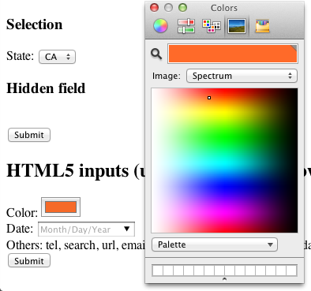
HTML5 input elements
color
tel, url, email
date, datetime, month
week, time, ...
number, range

Slide 22
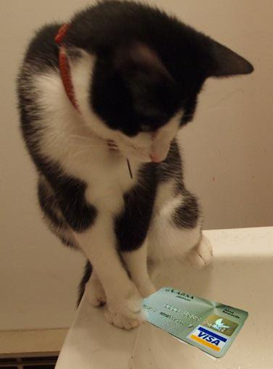
Good form design
goal of a form is to get the user to provide infomation
email address
credit card number
Yelp review
use the right input elements
checkbox vs radio?
text vs textarea?
the form is still HTML, so it can be (beautifully) styled with CSS

Slide 23
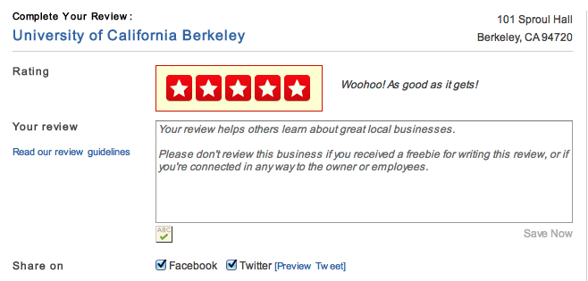
Example: Stars are radio buttons
<li>
<input id="rating-5" type="radio" name="rating" value="5">
<label for="rating-5" class="offscreen">5 (Woohoo! As good as it gets!)</label>
</li>

Slide 24
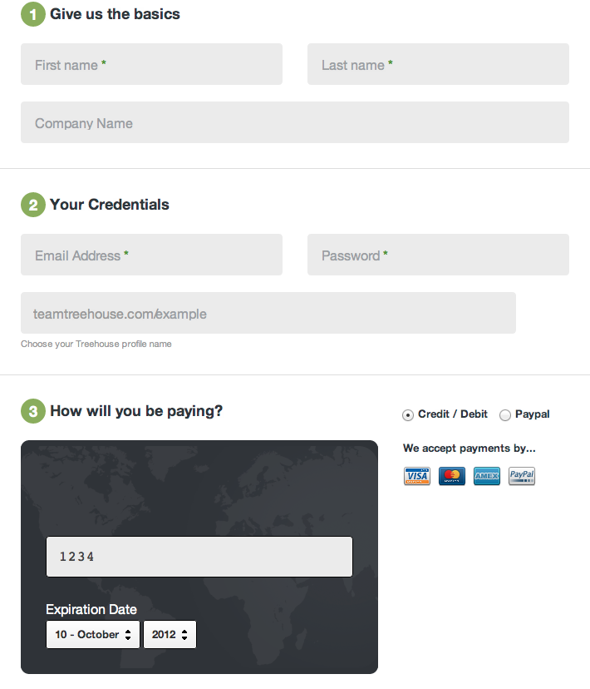
Notes:
super cool credit card entry - anytime you can make someone feel good about entering a credit card, you're doing something right

Slide 25
How do you do use with Forms?
By default when you submit a form, the values are sent to a HTTP server.
Most of the time these values are handled by server side languages.
HTML + CSS alone won't cut it.

Slide 26
Form Posts
Mosts forms don't just put parameters on the redirected URL
Instead of making a normal "GET" request to a server, we make a "POST"
When you make a "POST" request the parameters are sent as data

Slide 27
Behind the HTTP Veil
GET /login?username=ilovecats&password=secret
Host: www.mysite.com
User-Agent: Mozilla/4.0
Content-Length: 27
Content-Type: application/x-www-form-urlencoded

Slide 28
GETs vs POSTs
GET /login?username=ilovecats&password=secret
Host: www.mysite.com
User-Agent: Mozilla/4.0
Content-Length: 27
Content-Type: application/x-www-form-urlencoded
POST /login
Host: www.mysite.com
User-Agent: Mozilla/4.0
Content-Length: 27
Content-Type: application/x-www-form-urlencoded
username=ilovecats&password=secret

Slide 29
What's a server side language?
<form action"/login">
<input type="text" name="username"/> <input type="password" name="password'"/>
<input type="submit"/>
</form>
POST /login HTTP/1.1
Host: www.mysite.com
User-Agent: Mozilla/4.0
Content-Length: 27
Content-Type: application/x-www-form-urlencoded
username=ilovecats&password=secret
HTTP/1.1 200
Content-Type: text/html
Content-Length: 73
<html>
<body>
<p> Welcome back ilovecats! </p>
</body>
</html>
Web Server
with
Server Side Language

Slide 30
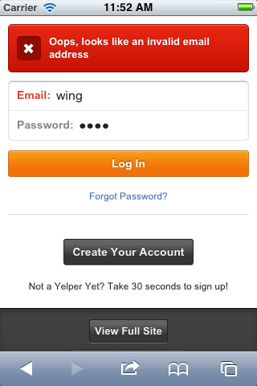
How can forms be improved?
give users early and complete feedback on how they are doing
catch simple errors at the client before submission to the server
not doing a complete page refresh if possible
Notes:
cutting down on roundtrips to server

Slide 31
Introduction to JavaScript
Javascript first appeared on Netscape Browsers in 1995
Its name was created for marketing reasons as a lighter weight version of Java.
Currently the ECMA standards body has defined a new ECMAscript standard

Slide 32
JavaScript
Allows you manipulate a web page without having to refresh the page.
Allows deep user interaction with a web application.
Is a full featured "Turing Complete" programming language.

Slide 33
Javascript IRL
Apple refuses to allow flash on their devices.
Web 2.0 and the Dynamic Web.
Google Search Suggest.
Mobile Web Applications.

Slide 34


JavaScript libraries
Provide a layer of abstraction for common functionality
Handle cross-browser issues
Most professional JS development uses a library
Notes:
will show some examples side-by-side with jQuery

Slide 35
Break
Go check your facebook and appreciate their awesome javascript!

Slide 36
What we're going to do with JS
manipulate the DOM (HTML)
validate form values
make AJAX calls

Slide 37
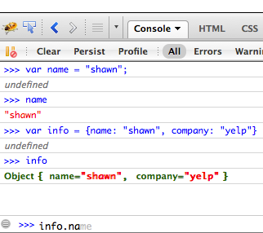
The JS console is your best friend
Notes:
learn about the JS language

Slide 38
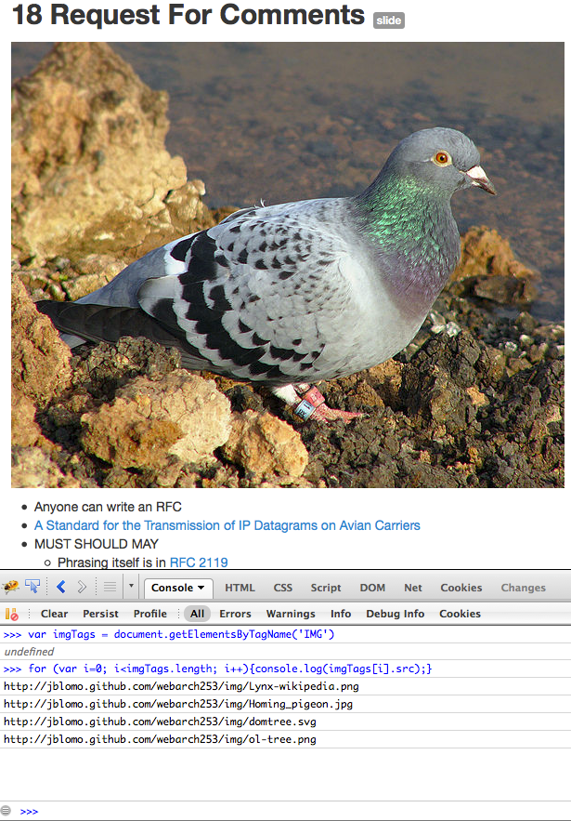
Notes:
interact with and debug pages

Slide 39
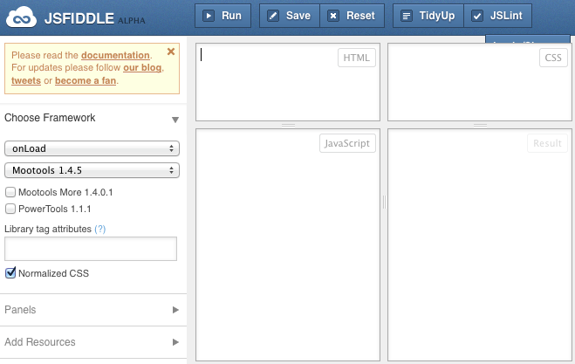
jsfiddle is also great

Slide 40
Variables
var a = 3;
var b = 5;
var c = a + b;
c is now the number 8

Slide 41
JavaScript Strings
var a = 'hello ';
var b = 'world!';
var c = a + b;
c is now the string 'hello world!'

Slide 42
Javascript Objects
var shawn = {kittens: 0, hackerSkillz: 'l337'};
'shawn.kittens' is now 0, 'shawn.hackerSkillz' is now 'l337'
var couple = {girlfriend: {kittens: 1, hackerSkillz: 'nub'}, boyfriend: shawn};
'couple.girlfriend.kittens' is 1, 'couple.girlfriend.hackerSkillz' is 'nub'
'couple.boyfriend.kittens' is 0, 'couple.boyfriend.hackerSkillz' is 'l337'

Slide 43
Functions
var add = function(a, b) {return a + b;}
var c = add(2, 7)
c is now 9
var arithmetic = {add: add, subtract: function(a, b) {return a - b;}};
var d = arithmetic.subtract(11, 4);
var e = arithmetic.add(0, 3);
d is now 7; e is now 3;

Slide 44
The DOM
Stands for "Document Object Model"
Every webpage has an object called "document" that holds every element in it.
The "document" object allows modification of the html with javascript.

Slide 45
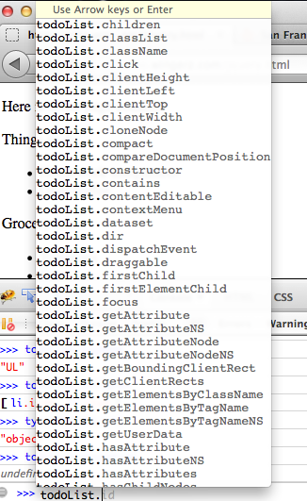
Inspecting the DOM
Can access DOM nodes (these are objects that represent HTML tags)
HTML Element objects have a lot of methods and properties

Slide 46
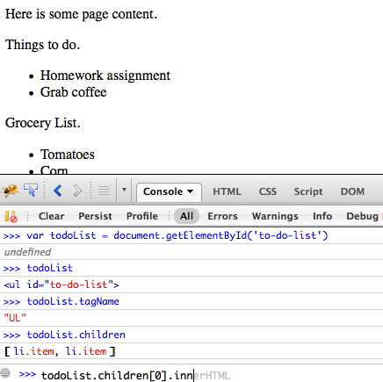
Inspecting the DOM
http://echo.wingerz.com/jquery.html

Slide 47
Inspecting the DOM (jQuery)
Raw JS:
document.getElementById('to-do-list')
Can only use getElementById, getElementsByTagName, and getElementsByClassName
Which would you use to figure out how many <form> tags on facebook.com?
jQuery:
$('#to-do-list')
Can use any CSS selector
$('#to-do-list li.item')

Slide 48
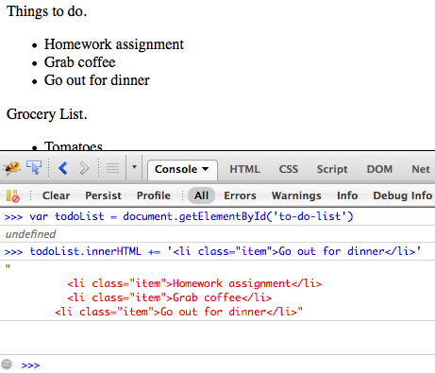
Modifying the DOM
.innerHTML is the HTML that is inside a node

Slide 49
Modifying the DOM (jQuery)
Raw JS:
document.getElementById('to-do-list').innerHTML += '<li class="item">Do Something</li>'
jQuery:
$('#to-do-list')
.append($('<li>')
.attr({class: 'item'})
.append('Do Something'))
Notice: chaining

Slide 50
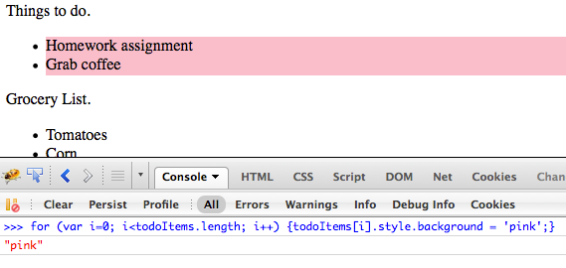
Apply CSS

Slide 51
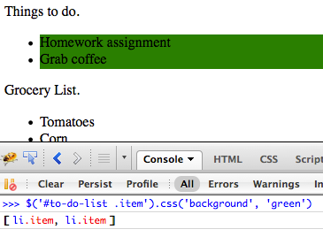
Apply CSS (jQuery)

Slide 52
Conditionals
if (something truthy) {
// do this stuff
} else {
// do this other stuff
}

Slide 53
Conditional quirks
What would you expect this to evaluate to?
"5" == 5

Slide 54
Conditional quirks
What would you expect this to evaluate to?
"5" == 5
true
Use === and !==

Slide 55
Regular Expressions
Used for matching string patterns
/^\d\d\d\d\d$/
//: creates a regular expression
^: match beginning of string
$: match end of string
\d: match a digit

Slide 56
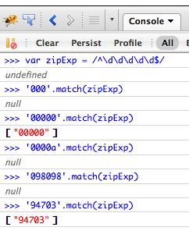

Slide 57

JavaScript Events
web browsing is event driven
what are some example events?
page scroll
clicking things
submitting forms
hovering over elements
page has finished loading everything it needs
jQuery (or some other library) is ready to do things

Slide 58
Whirlwind tour of events
An OK way to handle events:
<a href="#" onclick="someFunction();">
Raw JS:
element.addEventListener(...)
jQuery:
$('a.action').click(function(event) {...});
$.bind/on/click/delegate/etc. are all related to attaching event handlers
Notes:
i'd say go over this pretty quickly

Slide 59
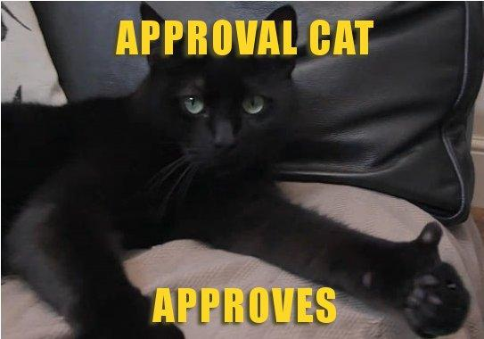
Example: Form validation
$('#test-form').submit(function(event) {
if ($('#happyyn').val() !== 'Y' && $('#happyyn').val() !== 'N') {
alert("Must enter 'Y' or 'N' for happiness.");
return false;
}
if (! $('#zip').val().match(/^\d\d\d\d\d$/)) {
alert("Zip code must be five digits in a row.");
return false;
}
});
http://echo.wingerz.com/validate.html

Slide 60
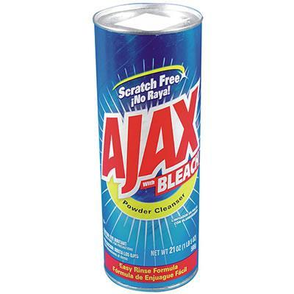
AJAX
Asynchronous JavaScript and XML
Allows the browser to make additional calls to a server
Why would you want to do this?

Slide 61
How to use AJAX
At its core: XMLHttpRequest
this is different in IE
most people just use libraries
all you usually care about is the URL and the data that comes back
jQuery: $.ajax, $.get*, $.post, etc.

Slide 62
Example: Making a request
$('#get-homework').click(function(event) {
$.ajax('/snippet', {
success: function(data) {
$('#ajax-snippet').append(data);
event.stopPropagation();
}
})
});
http://echo.wingerz.com/ajax.html

Slide 63
JSON
Most websites have a bunch of HTML, CSS, and Javascript
When you make an ajax call you usually want just a little bit of data.
JSON is a specification of a javascript object as a string. Like "{smells: 'funny': kittens: 7}"
You can then convert this string to a real javascript object.

Slide 64
Example: talking to an API
var business_name;
$.get('http://api.yelp.com/v2/search?term=italian+food', function(json) {
business_name = json.business.name;
}
when the call is done, 'business_name' will be "Gypsy's";

Slide 65
Conclusion
With HTML, CSS, and Javascript you now have all the tools you need to make a great clientside webpage
Happy Hacking!

